Slide 1

Presentation by
Obesity
Part One/Course 1
Dr Rob Grieve

Slide 2
Aims/Objectives/Content
Brief overview of pathophysiology related to obesity/overweight population-Set the Scene.
To recognise the benefits of physical activity and exercise in the management treatment of obesity.
Appreciate the complexity of exercise programming for obesity and its associated
co-morbidities
To demonstrate evidence based practice in clinical exercise.

Slide 3
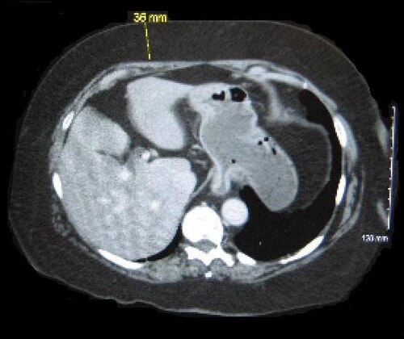
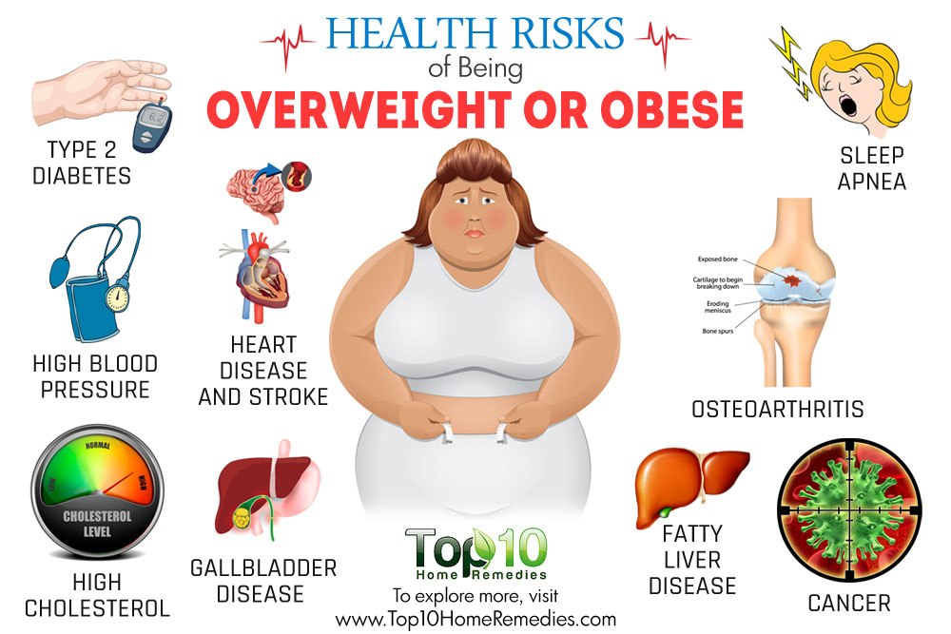
What is Obesity?
Obesity is defined as ‘abnormal or excessive fat accumulation that may impair health’ and is often attributed to low levels of physical activity and a disproportionate energy intake (Hill et al., 2012; World Health Organisation, 2017).
Obesity is classified following prolonged
weight gain when the body’s energy stores of
fat exceed those that are expended.
Notes:
What do you think is old?
Environmental stresses.
Immune system compromise – can this be boosted with activity? Use studies to support.

Slide 4
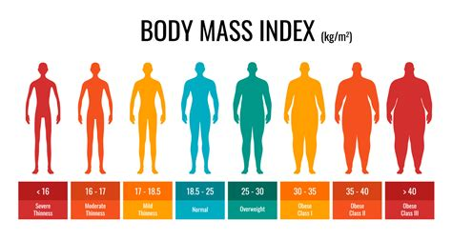
WHO Definition of Overweight and Obesity
A diagnosis of overweight or obesity is made by measuring people’s weight and height and by calculating the body mass index (BMI): weight (kg)/height² (m²).
The body mass index is a marker of fatness and additional measurements, such as the waist circumference, can help the diagnosis of obesity.
Also, calculating body fat percentage (is the amount of your total body weight that's made up of fat) using skinfold calipers.
The BMI categories for defining obesity vary by age and gender
for adults, adolescents, children and infants.
Adults- overweight is a BMI greater than or equal to 25; and
obesity is a BMI greater than or equal to 30.
TASK: Is BMI a reliable or valid measurement of obesity?

Slide 5
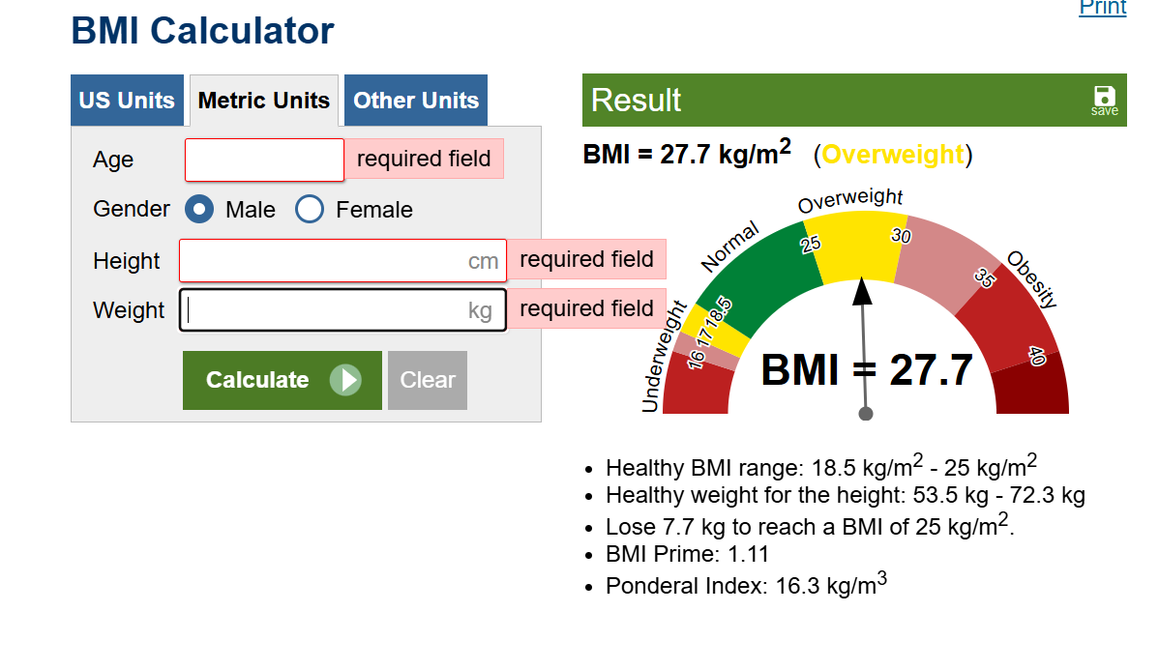
Calculate BMI Height/Weight BMI Calculator Link

Slide 6
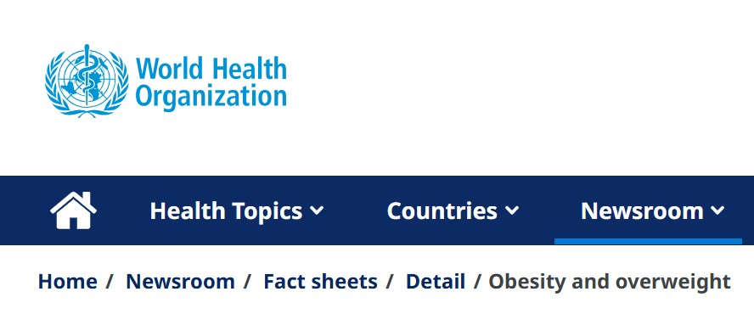
Obesity-Key Facts (WHO: Dec 2025)
In 2022, 1 in 8 people in the world were living with obesity. Worldwide adult obesity has more than doubled since 1990, and adolescent obesity has quadrupled.
In 2022, 2.5 billion adults (18 years and older) were overweight. Of these, 890 million were living with obesity.
In 2022, 43% of adults aged 18 years and over were overweight and 16% were living with obesity.
In 2024, 35 million children under the age of 5 were overweight. Over 390 million children and adolescents aged 5–19 years were overweight in 2022, including 160 million who were living with obesity.

Slide 7
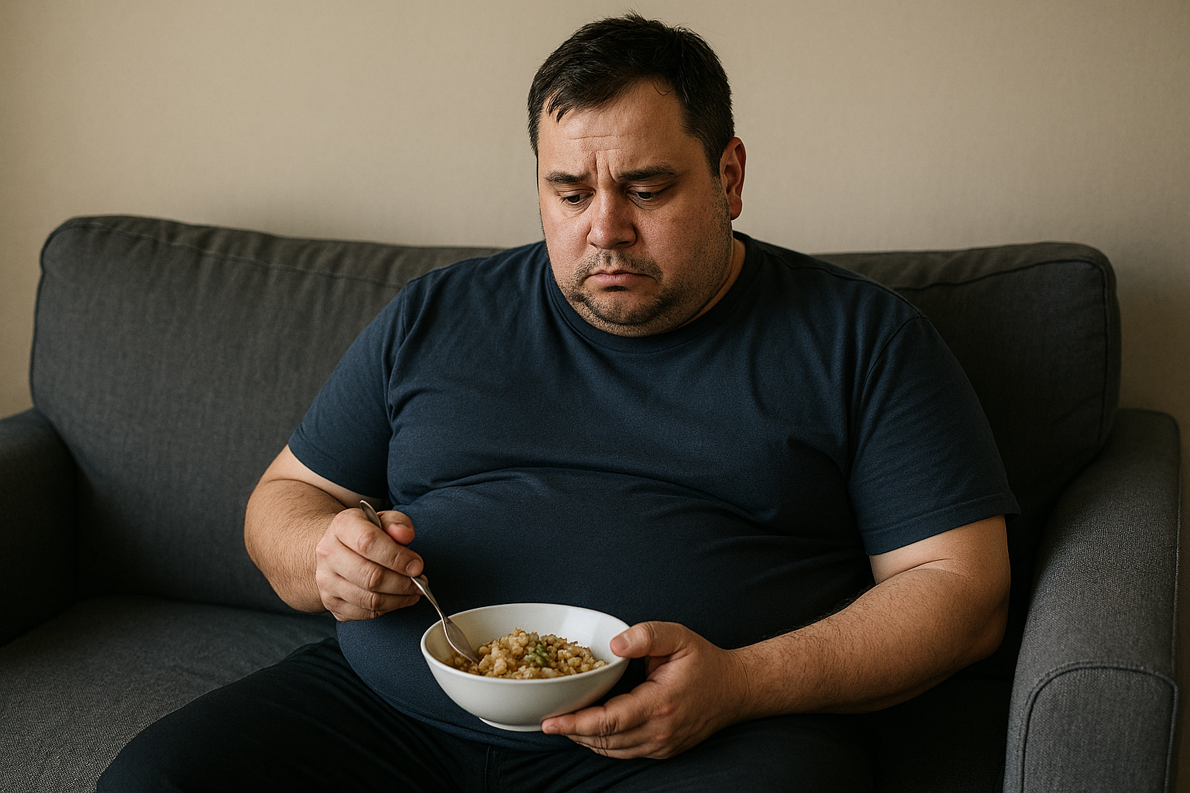
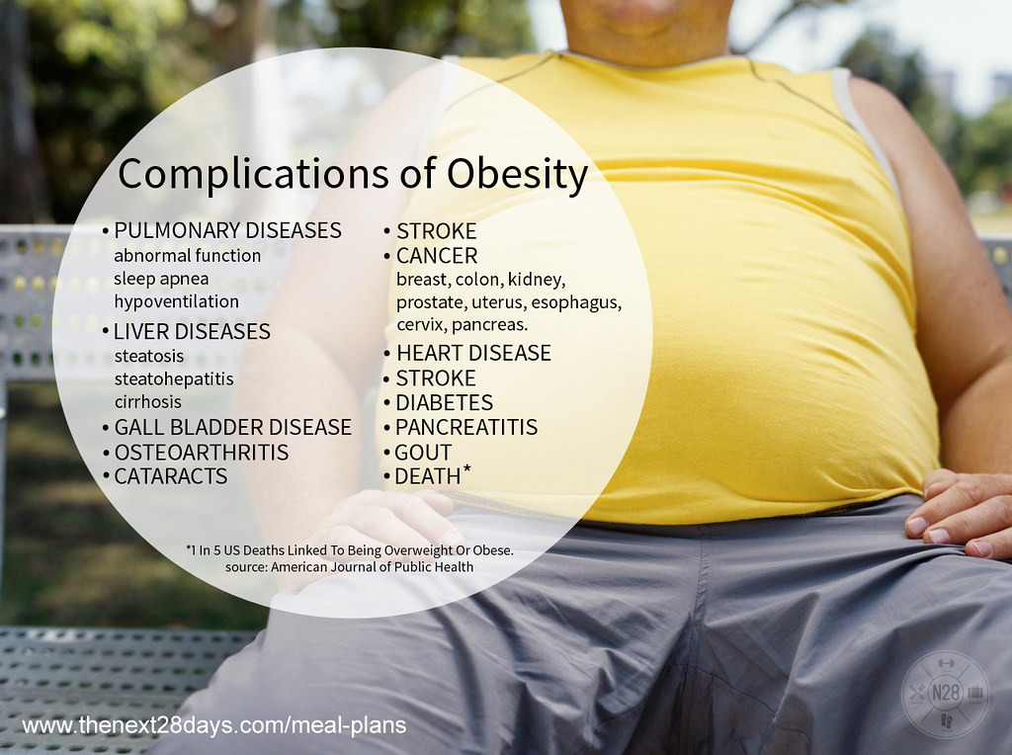
Causes of Obesity
The main cause of overweight and obesity is physical inactivity, excessive sedentary behaviour and/or increased calorie consumption (Herring and Broom, 2022)
HOWEVER, weight gain can be a result of medical conditions (e.g. endocrine disorders, hyperthyroidism) or a side effect of medications and smoking cessation.
It can also be the result of genetic disorders e.g. Prader-Willi syndrome, and whilst genes play a role in the development of obesity, the gene pool has not changed that significantly in recent decades to be the main contributing factor (Herring and Broom, 2022).
Notes:
What do you think is old?
Environmental stresses.
Immune system compromise – can this be boosted with activity? Use studies to support.

Slide 8
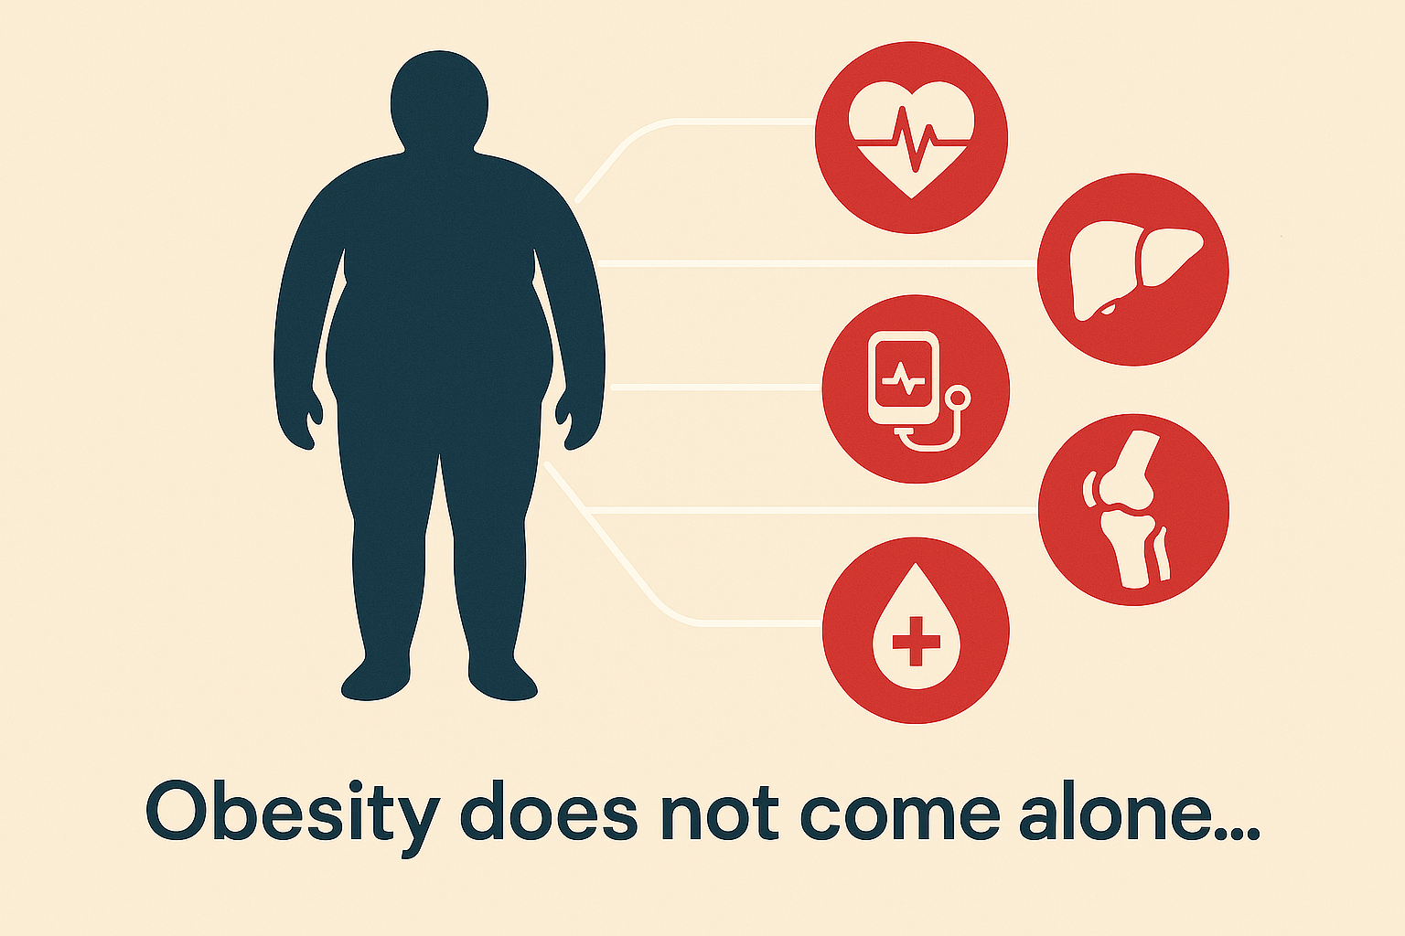
Obesity Co-morbidities Literature identified by Herring and Bloom, (2022)
The rising prevalence of obesity is contributing to significant cardio-metabolic complications and higher rates of obesity-related diseases (Vinciguerra et al., 2013), such as T2DM,CVD, dyslipidemia (cholesterol/triglygerides) hypertension, obstructive sleep apnoea, arthritis and non-alcoholic fatty liver disease (Colquitt et al., 2009; Nguyen & Lau, 2012). Morbid obesity also contributes to reductions in physical function, walking speed and further increases the occurrence of disability (Herring et al., 2016).
Notes:
What do you think is old?
Environmental stresses.
Immune system compromise – can this be boosted with activity? Use studies to support.

Slide 9
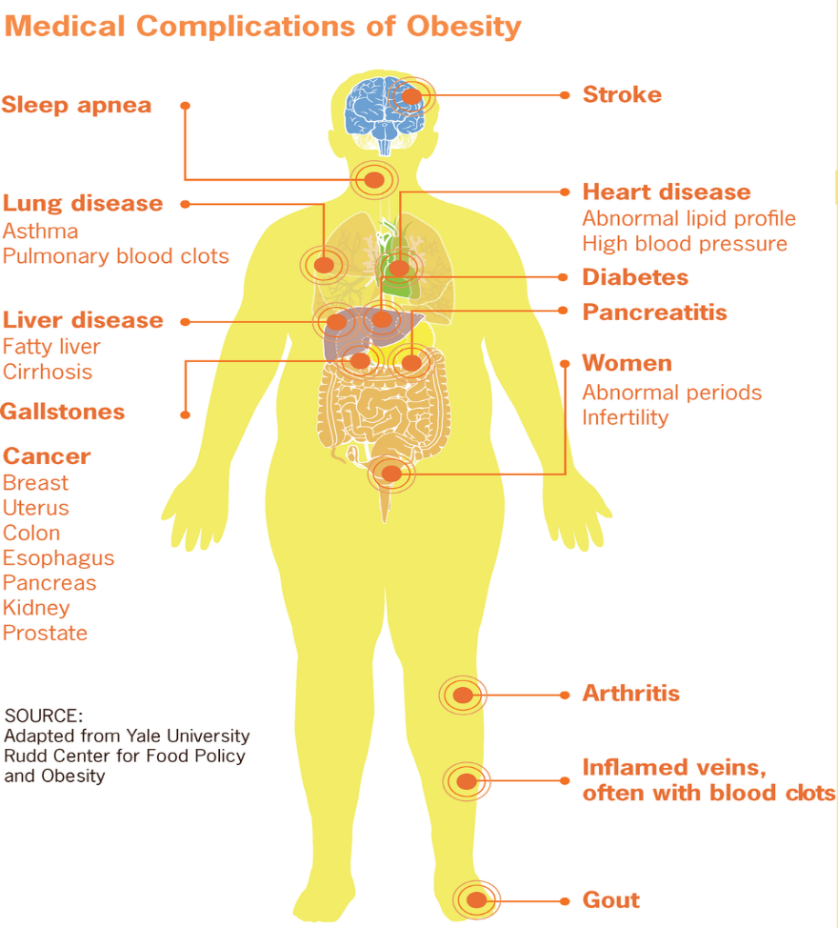
Obesity Co-morbidities
By CDC - This file was derived from: Adult Obesity-CDC Vital Signs-August 2010.pdf, Public Domain. https://commons.wikimedia.org/w/index.php?curid=20769610

Slide 10

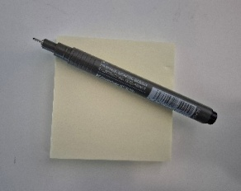
Group Activity
Obesity of itself may appear a minor health issue….BUT the co-morbidities associated with it are of serious medial concern.
Any thoughts on the co-morbidities associated with obesity?
Work in pairs, put ideas on a post-it or interactive board and then share with the group.

Slide 11
Physiological Changes in Obesity Due to Exercise
Improved insulin sensitivity and glucose uptake (Donnelly et al., 2009) Increased mitochondrial density and oxidative capacity (Haskell et al., 2007) Reduced chronic systemic inflammation (↓ CRP, ↓ IL‑6) (Colquitt et al., 2009) Improved lipid metabolism (↓ triglycerides, ↑ HDL) (Nguyen & Lau, 2012) Reduced visceral and ectopic fat stores (Vinciguerra et al., 2013) Increased cardiorespiratory fitness (↑ VO₂max) (Herring et al., 2016) Enhanced strength, muscle endurance and functional capacity (Williams et al., 2007)
SEE REFERENCE LIST TO EXPLORE PHYSIOLOGICAL CHANGES FURTHER.

Slide 12
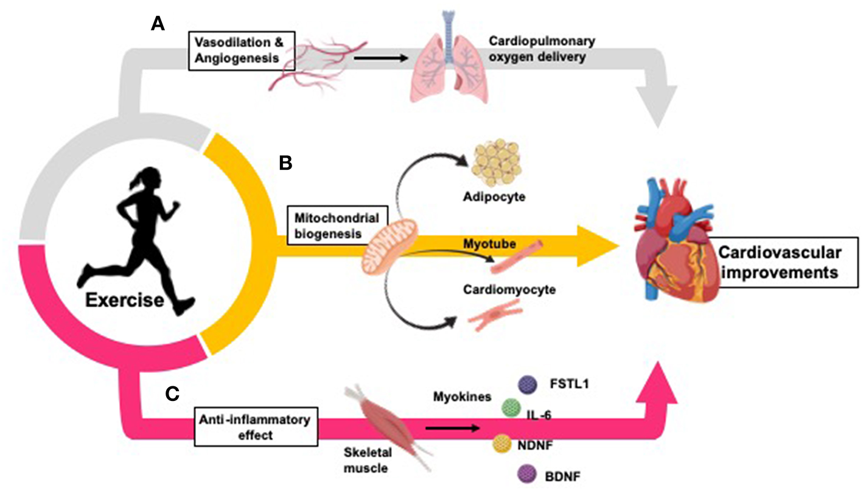
Exercise improves cardiovascular health by inducing changes in oxygen delivery, vasculature, peripheral tissues, and inflammation. (A) Exercise improves oxygen delivery throughout the body through promotion of vasodilation and angiogenesis (107–110). (B) Exercise increases mitochondrial biogenesis in adipocytes (104, 111, 112), skeletal muscle myotubes (113), and cardiomyocytes (14, 114, 115). (C) Exercise causes a long-term anti-inflammatory effect (which is inversely related to the increased inflammation typically seen in CVD and obesity) (116). Myokines released from skeletal muscle during physical exercise partially mediate these anti-inflammatory effects and promote inter-tissue cross talk to mediate further cardiovascular benefits (117–120).
(Pinckard, Baskin and Stanford, 2019) Effects of Exercise to Improve Cardiovascular Health (Ref List)

Slide 13
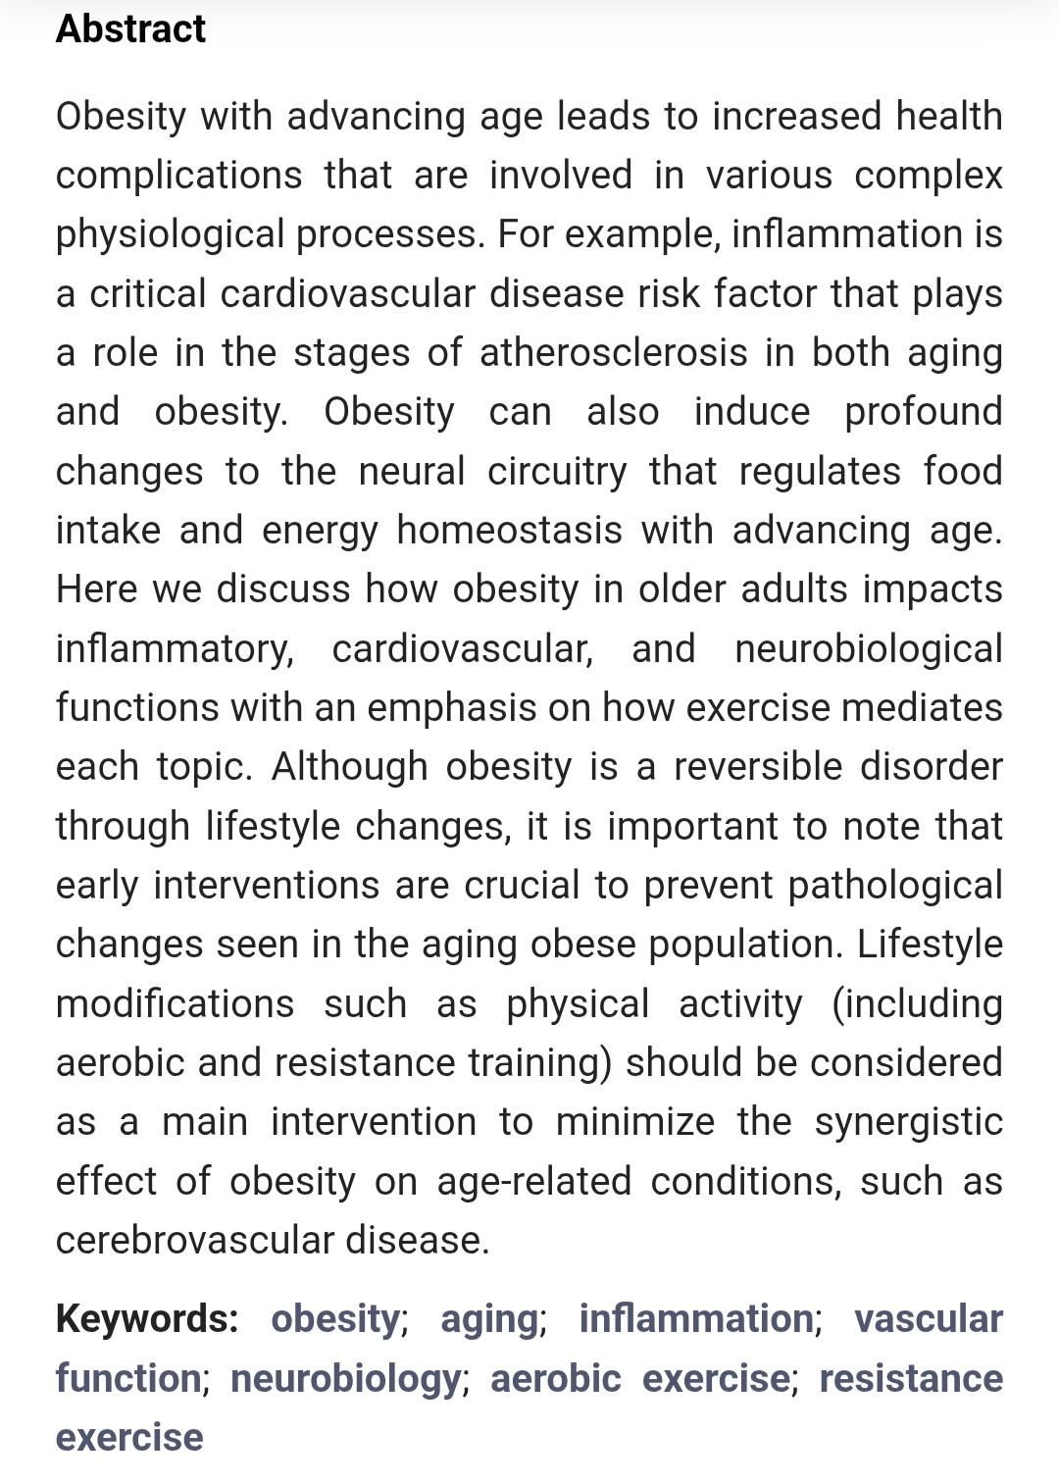
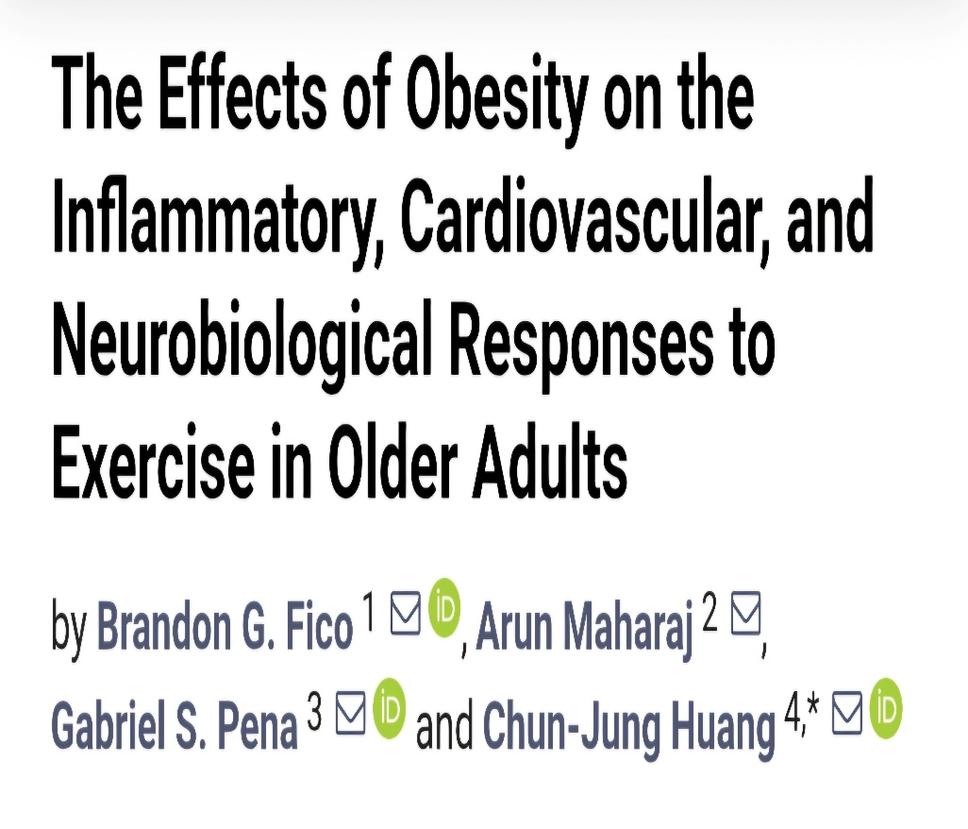














Slide 14
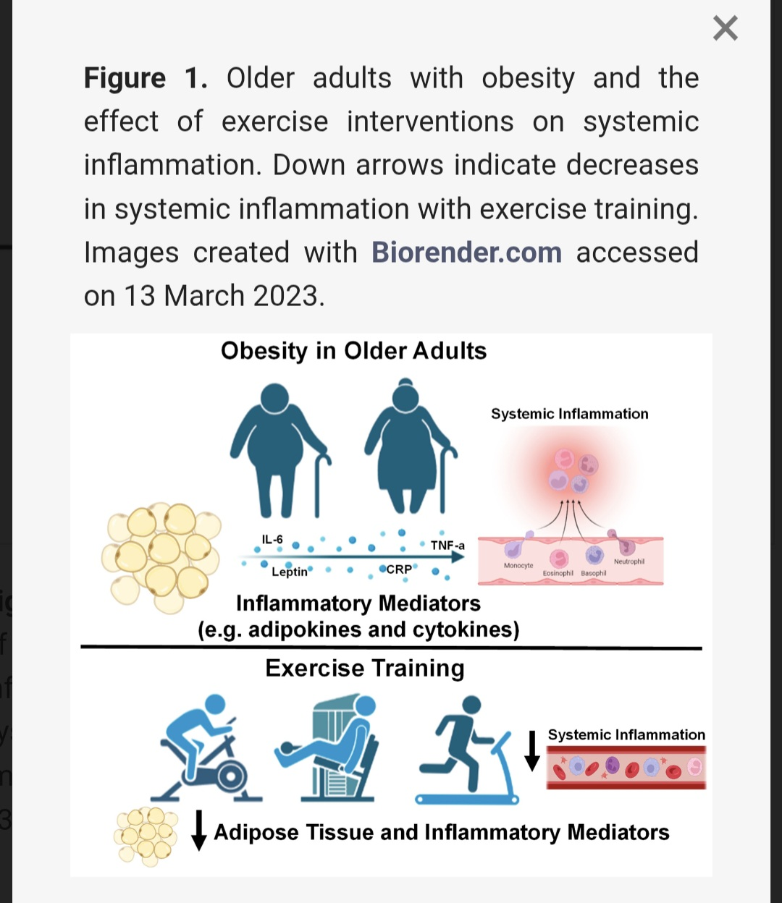
Effect of exercise on systemic inflammation (Fico et al., 20123)

Slide 15
Medicines to manage your weight
Overweight and obesity management NICE guideline. Reference number:NG246. updated: 08 January 2026
Medicines may be recommended to help support weight loss and weight management in adults if healthy lifestyle changes (such as eating healthily and exercising more) are not helping on their own.
Many different types of weight management medicines have been tested in clinical trials, but the only ones that have proved to be safe and effective for use on the NHS for weight management are: orlistat, liraglutide, semaglutide and tirzepatide
Should only use weight management medicines, if recommended/prescribed by a doctor/pharmacist. They will look at your individual health needs to decide if the medicine is safe and right for you, taking into account the benefits and any possible side effects.
All medicines for supporting weight management should be used alongside a reduced-calorie diet and increased physical activity.
TASK: What are your thoughts on medication? Medication instead of exercise or both?

Slide 16

Group Activity
Any takeaways from this session?
Has it helped you in your understanding of Obesity in respect of exercise prescription?
Work in pairs, put ideas on a post-it or interactive board and then share with the group.

Slide 17

Any Questions?

Slide 18
Next-PART TWO (Course 2)
AIM:
To apply the principles of planning and designing
an exercise progamme/prescription for special
populations.

Slide 19
References
Colquitt, J. L., Picot, J., Loveman, E., & Clegg, A. J. (2009). Surgery for obesity. Cochrane Database of Systematic Reviews, 2, CD003641. https://doi.org/10.1002/14651858.CD003641.pub3 Donnelly, J. E., Greene, J. L., Gibson, C. A., Smith, B. K., Washburn, R. A., Sullivan, D. K., et al. (2009). Physical activity across the curriculum (PAAC): A randomized controlled trial to promote physical activity and diminish overweight and obesity in elementary school children. Preventive Medicine, 49, 336–341. Debeaumont, D., Tardif, C., Folope, V., Castres, I., Lemaitre, F., Tourny, C., et al. (2016). A specific prediction equation is necessary to estimate peak oxygen uptake in obese patients with metabolic syndrome. Journal of Endocrinological Investigation, 39, 635–642. Fico BG, Miller KB, Somani YB, et al. (2023) The effects of obesity on the inflammatory, cardiovascular, and neurobiological responses to exercise in older adults. Biology (Basel). 2023;12(6):865. Haskell, W. L., Lee, I.-M., Pate, R. R., Powell, K. E., Blair, S. N., Franklin, B. A., et al. (2007). Physical activity and public health: Updated recommendations for adults from the American College of Sports Medicine and the American Heart Association. Medicine & Science in Sports & Exercise, 39, 1423–1434. Herring and Broom, in Andrew Scott, David Broom (2022) Exercise Management for Referred Medical Conditions, Taylor & Francis, London. Hill, J. O., Wyatt, H. R., & Peters, J. C. (2012). Energy balance and obesity. Circulation, 126(1), 126–132. Nguyen, T., & Lau, D. C. (2012). The obesity epidemic and its impact on hypertension. Canadian Journal of Cardiology, 28, 326–333.

